Slide 1
PIPELINE + TOOL

Slide 2
SUMMARY
1. Fill in Masterdata
2. Brand Pipeline
3. Repacking Pipeline
4. BOM - Repacking
5. Process SAP Data with the “Tool”
6. Repacking Order
7. Brand Order
8. Revise QTY

Slide 3
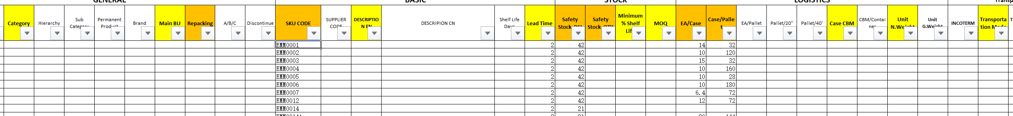
1. Fill Important Information in Sheet “MASTERDATA”
Orange : Very Important
Yellow : Important
1.SKU LIST
2.LEAD TIME
3.For Repacking SKU Write YES in Column “Repacking”
4.Safety Stock DSI or Safety Stock QTY

Slide 4
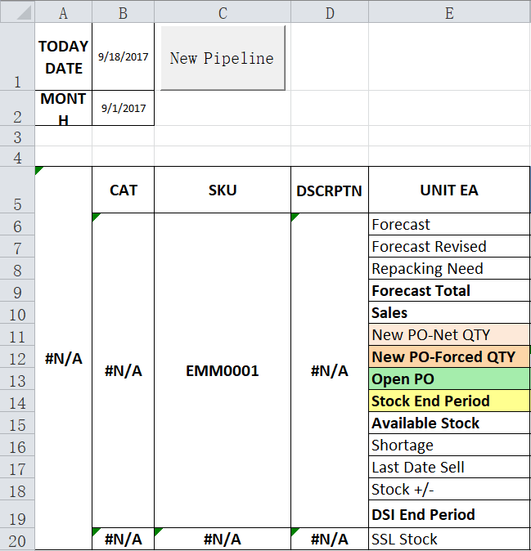
2. BRAND PIPELINE
The button “New Pipeline” will create the pipeline with the list of SKU in the Masterdata. It will not take Repacking SKUs.

Slide 5
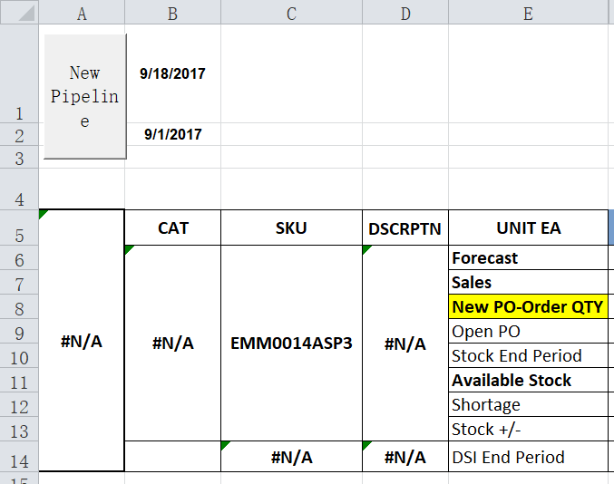
3. REPACKING PIPELINE
This button will create the pipeline with the list of SKU in the with “YES” in the Column “Repacking” Masterdata

Slide 6
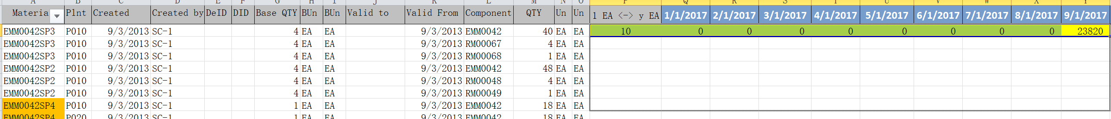
4. BOM - Repacking
Download BOM on SAP – Selection P010 to P010
Paste it in A1
Stretch 1st Line formula to the bottom

Slide 7
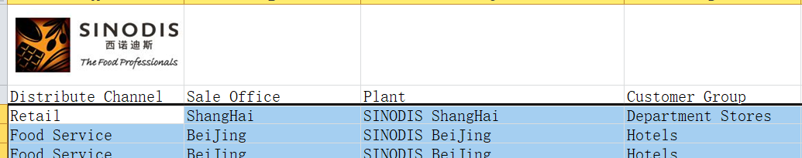
5.PROCESS SAP DATA
Copy everything except the first Header Line
Use SHIFT+CONTROL+DOWN ARROW + RIGHT ARROW
When doing right arrow make sure to select until the last column

Slide 8
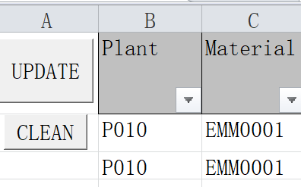
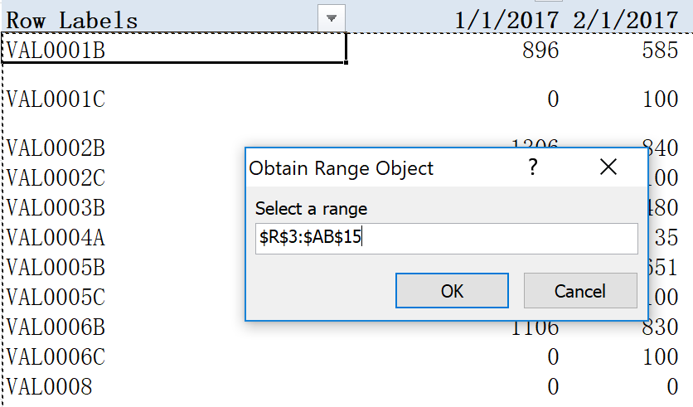
FORECAST/SALES
TOOL
PASTE in B2
UPDATE
Select All the information in Pivot

Slide 9
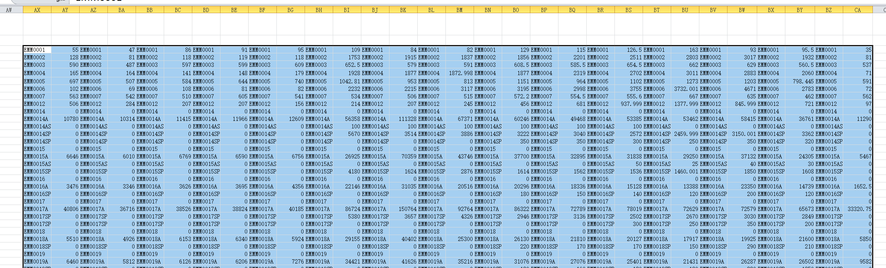
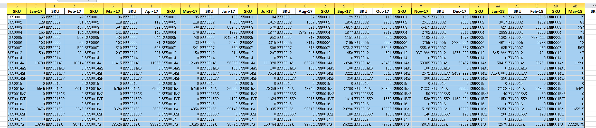
TOOL
FORECAST/SALES
PIPELINE
FORECAST/SALES

Slide 10
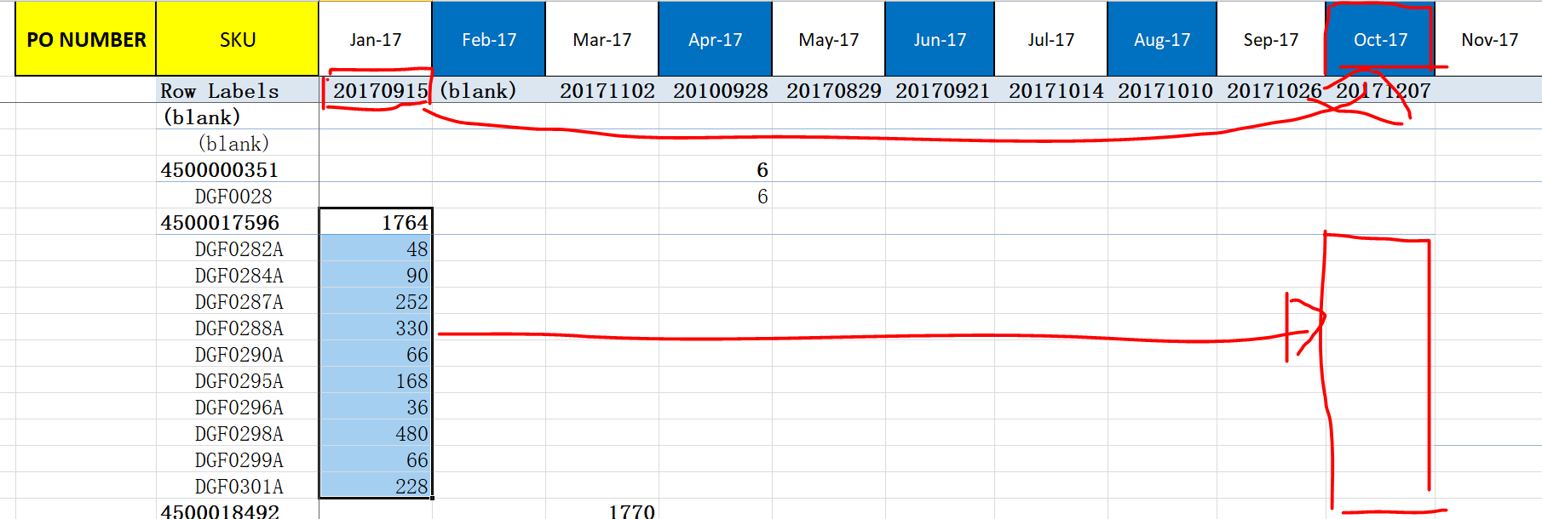
OPEN PO
Copy Pivot Table from Tool into Pipeline “Open PO” Sheet
Move QTY into Good months Warehouse ETA (SAP ETA are Port ETAs)

Slide 11
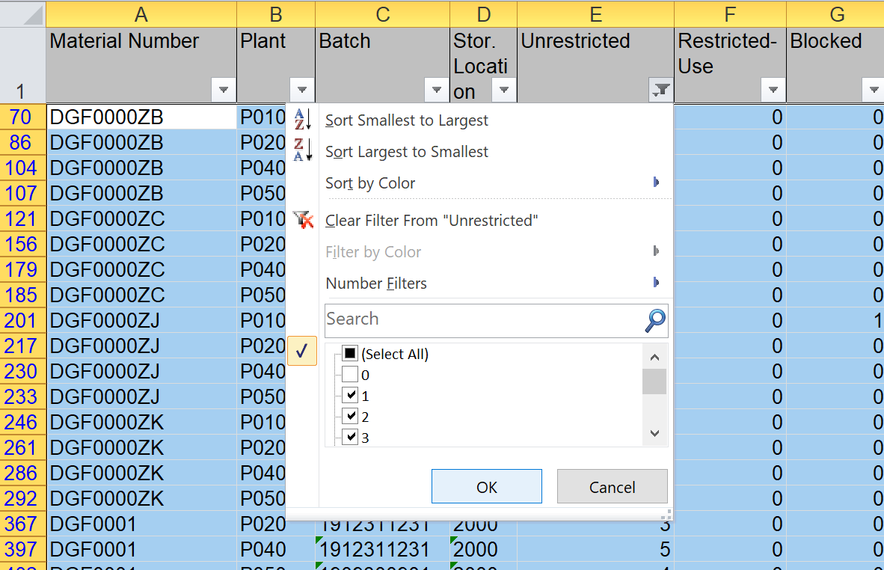
BMBC SAP
1. Filter Data, Unselect 0 in “Unrestricted” Column
2. Then Copy/Paste from Line 2 Data into Tool
OPEN PO
PIPELINE

Slide 12
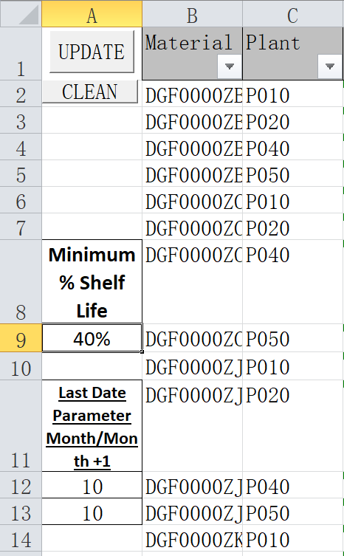
Parameters in Tool
1. Minimum % Shelf Life to be Available Stock
Example : Parameter % SL = 40%
39% SL : Used Stock
41% SL : Available Stock
2. Last Date Parameters
Example : Parameters = Day Month “> 10” and Month M+1 “< 5”
40% Shelf Life = 4 October 2017 - > Last Month to Sell = September 2017
40% Shelf Life = 15 October 2017 - > Last Month to Sell = October 2017
40% Shelf Life = 4 November 2017 - > Last Month to Sell = October 2017
40% Shelf Life = 6 November 2017 - > Last Month to Sell = November 2017

Slide 13
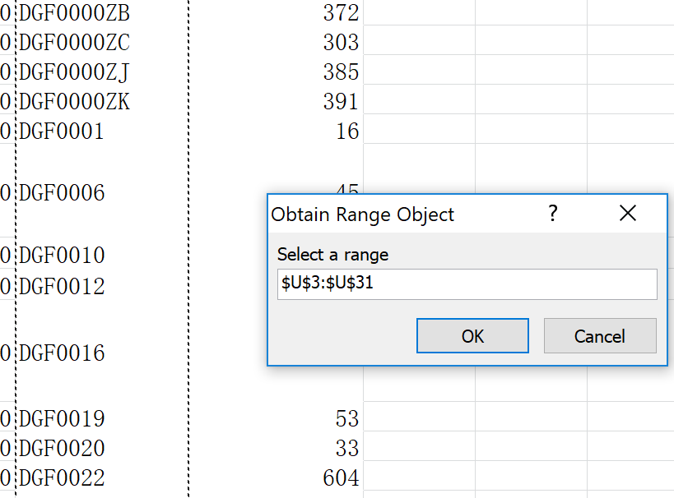
Select the SKU LIST

Slide 14
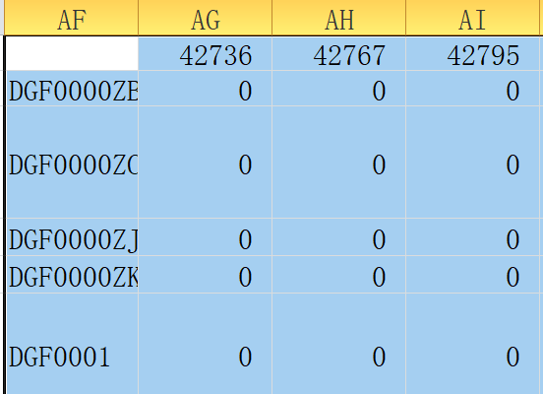
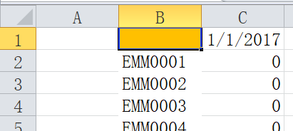
Last Date to Sell
TOOL
LASTDATE
LAST DATE
PIPELINE

Slide 15
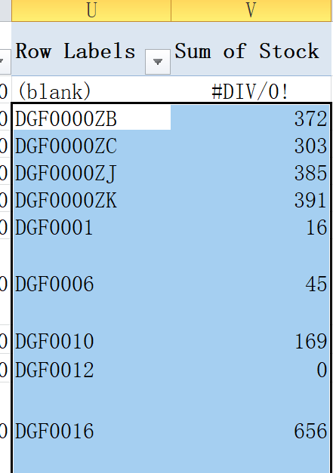
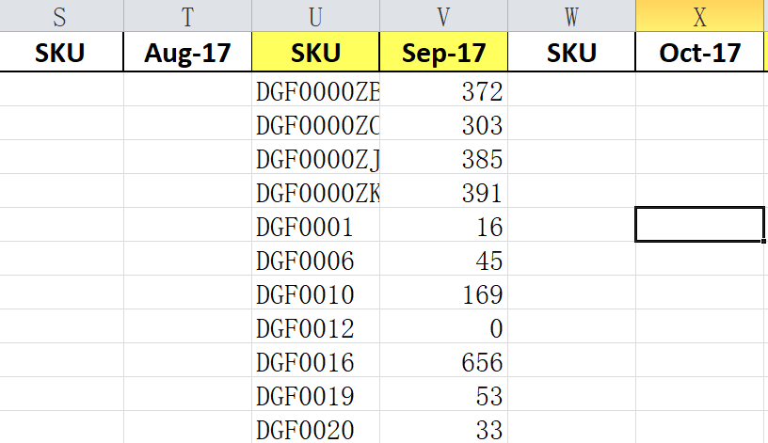
Stock
Copy Available Stock Data from Pivot
Paste Pipeline “Stock” In corresponding month
STOCK
STOCK
TOOL
PIPELINE

Slide 16
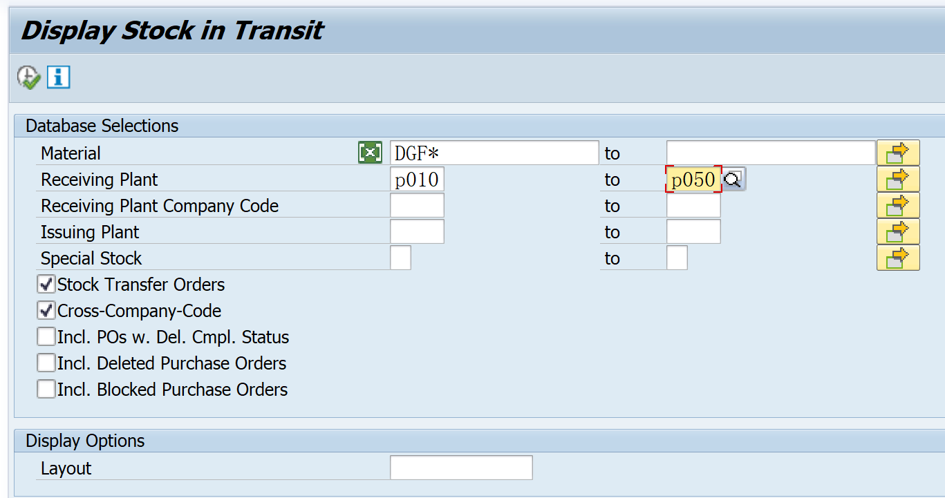
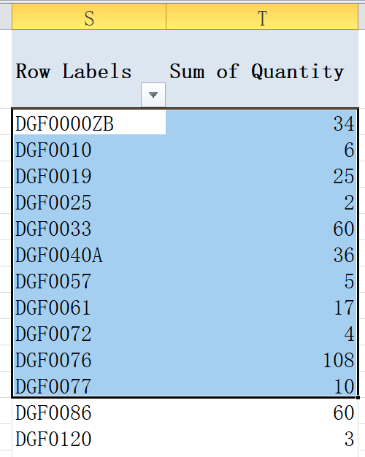
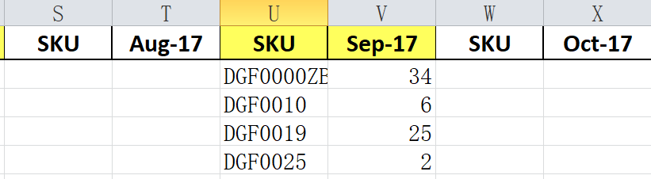
Stock in Transfer MB5T
MB5T
STOCK TRANSFER
STOCK TRANSFER
TOOL
PIPELINE

Slide 17
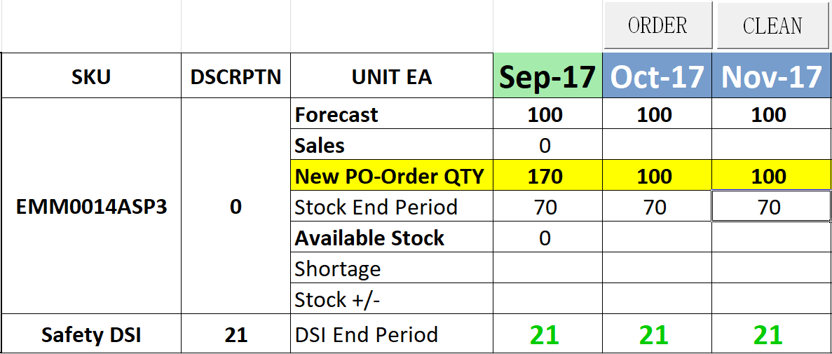
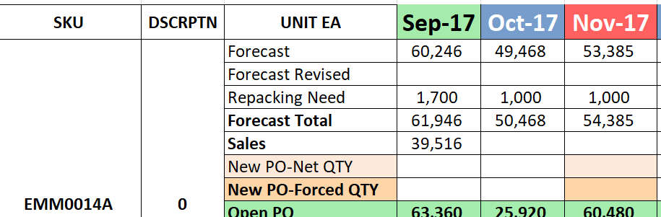
6. REPACKING ORDER
PIPELINE
Button Order will calculate the Repacking SKUs need/order
REPACKING
Repacking SKU need/order need will be convert into Forecast for corresponding SKUs according to the convert rate : 1 EA repacking product <-> y EA component
BOM
It will be add in Forecast of Component SKU in “Repacking Need”
BRAND

